Slide 1


Experiment 11
Six-pulse rectifier – common mode voltage and current – ground fault
Dr. Norbert Doerry and Dr. John V. Amy Jr.
http://doerry.org/norbert/MarineElectricalPowerSystems/index.htm
© 2024-2025 by Norbert Doerry and John Amy
This work is licensed via: CC BY 4.0 (https://creativecommons.org/)

Slide 2
Schematic
C_{p} = C_{p DC} =2.2 µF
R = 1200 Ω
R_{LD} = 300 Ω
R_{NDC} = 1200 Ω
R_{lamp} = 450 Ω
N = 5.2
R_{lamp}
Common Mode Current Probe
Current Meter (all phases)
Voltage Meter (all phases)

Slide 3
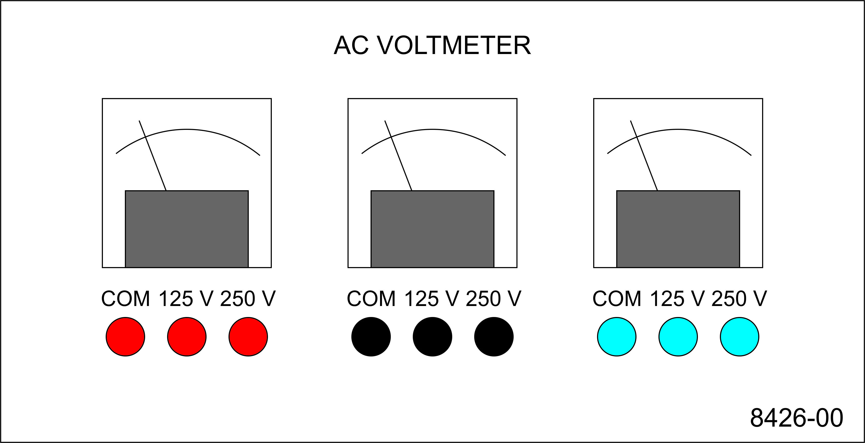
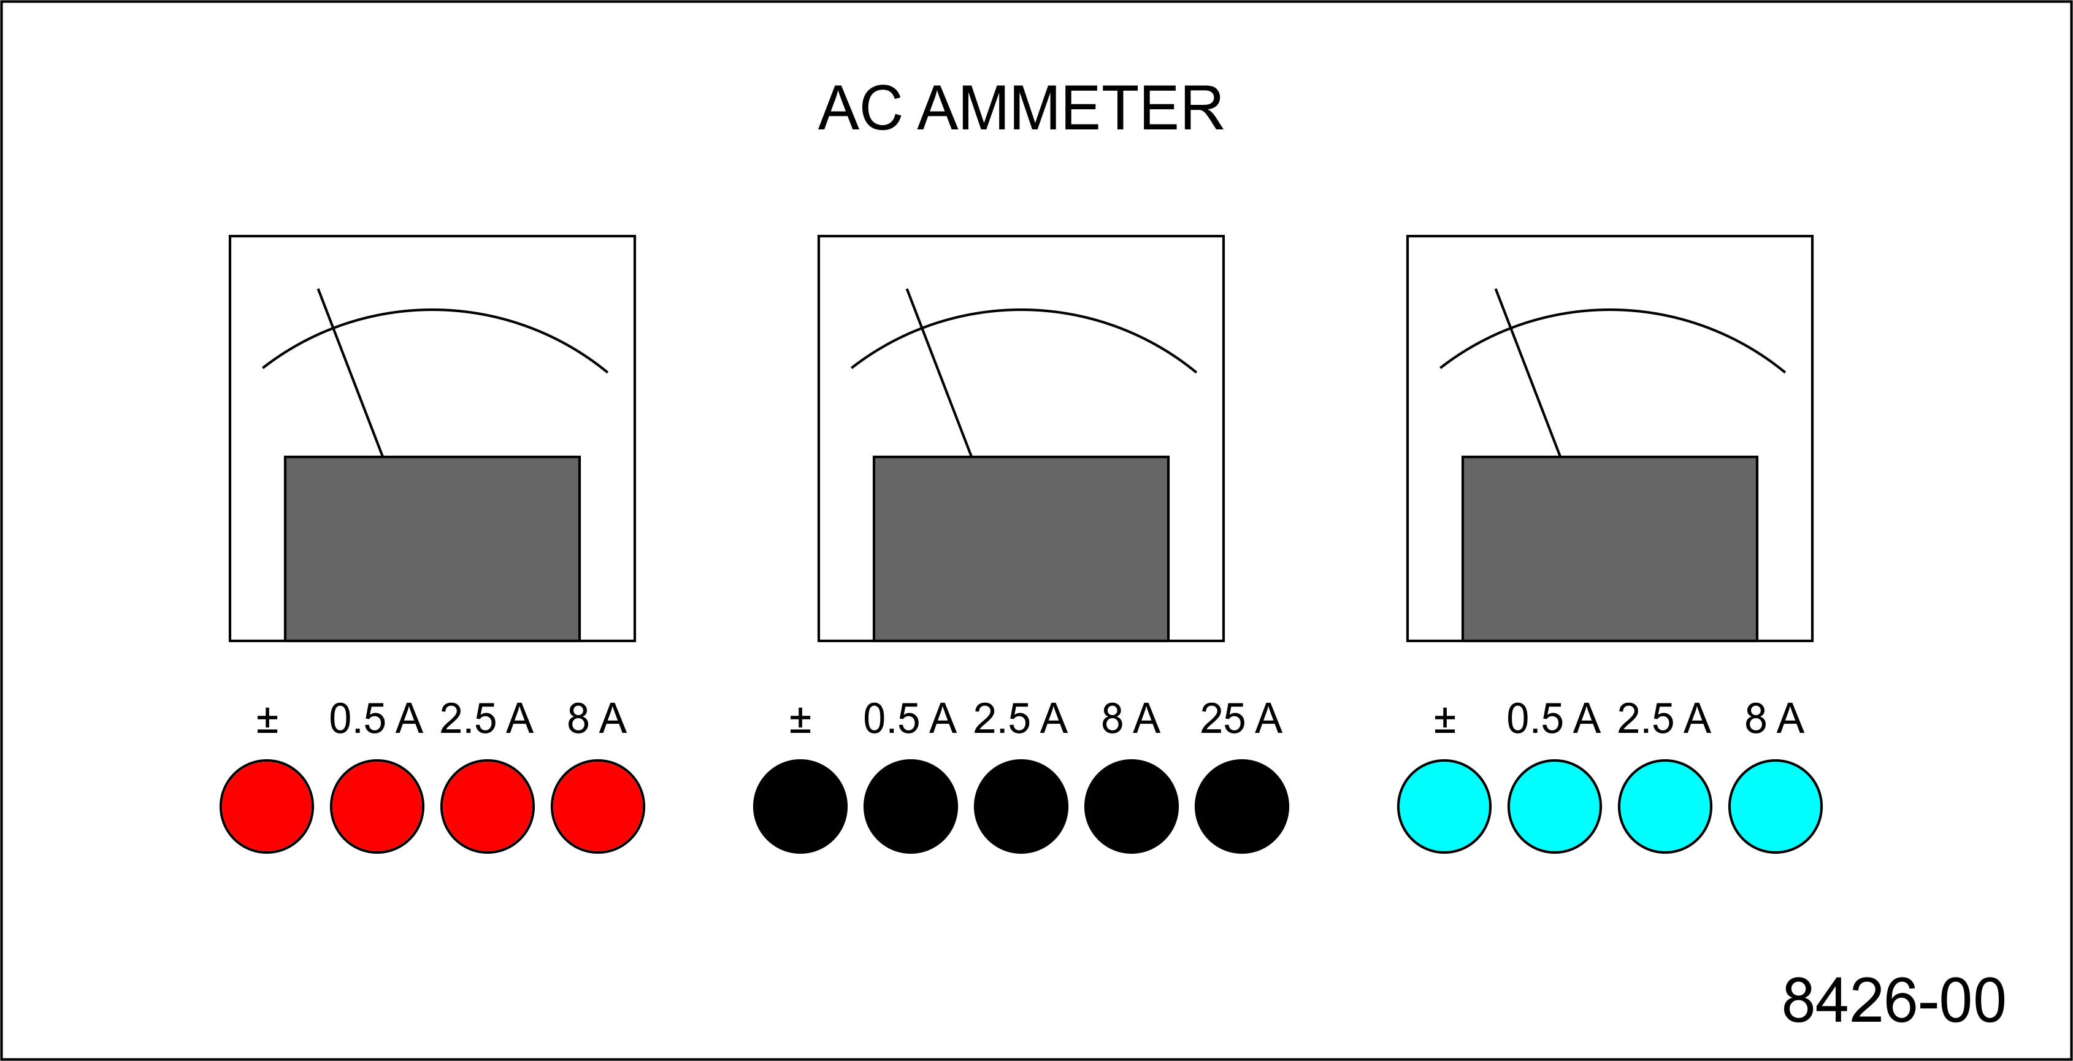
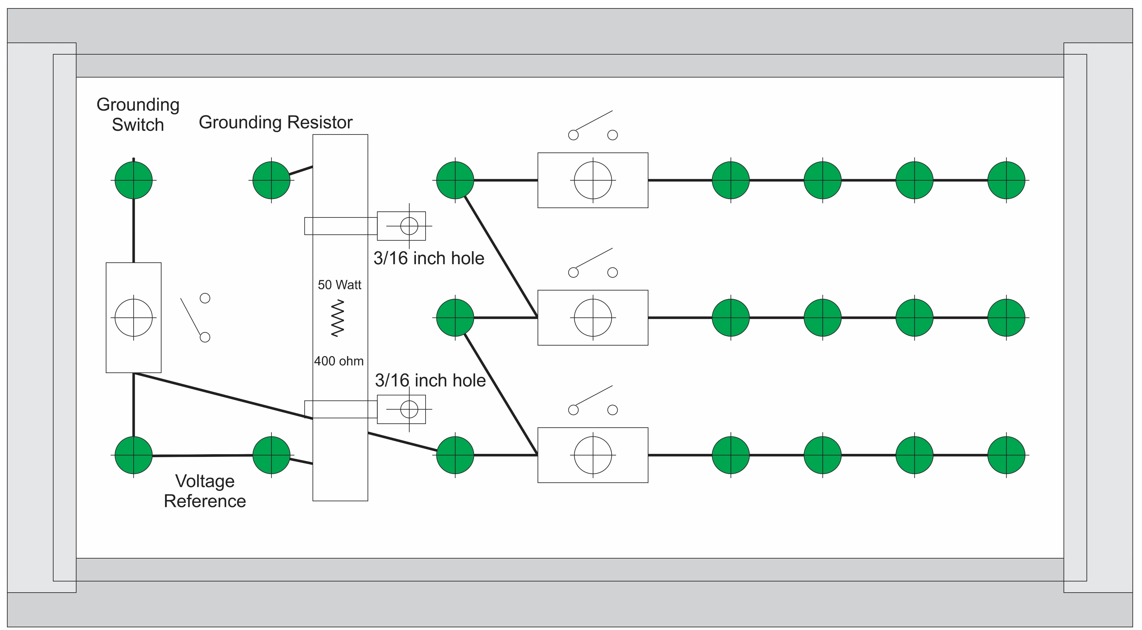
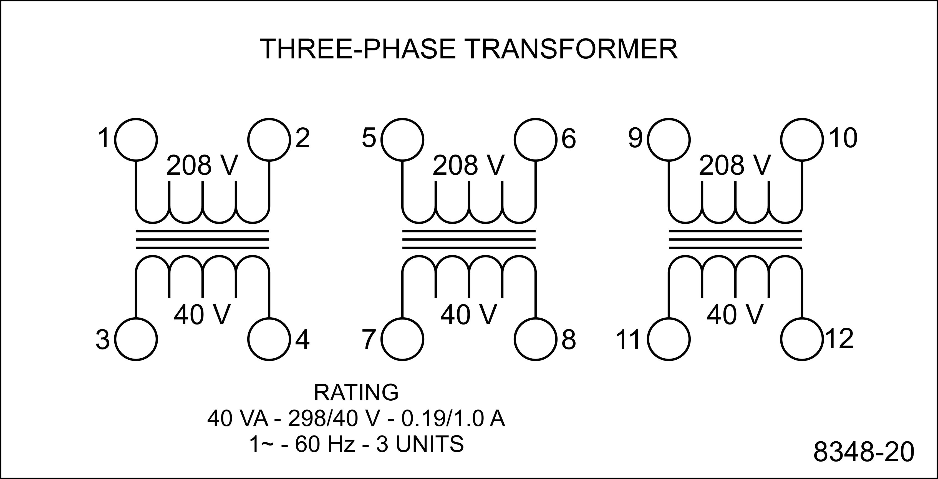
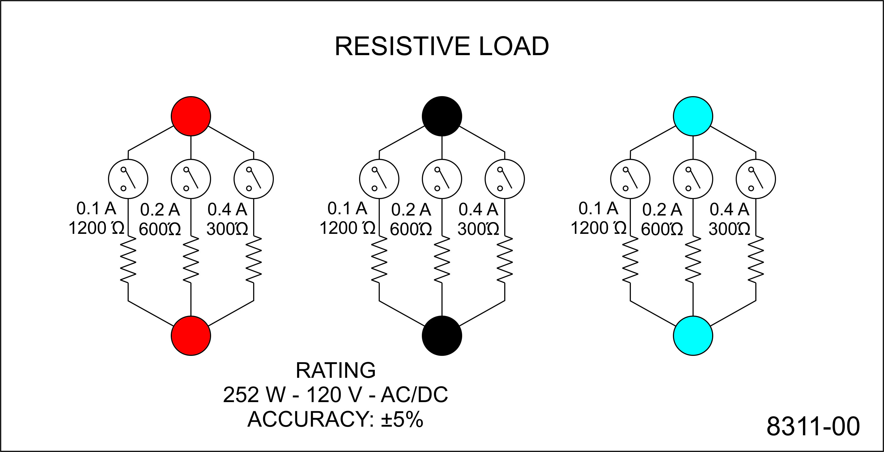
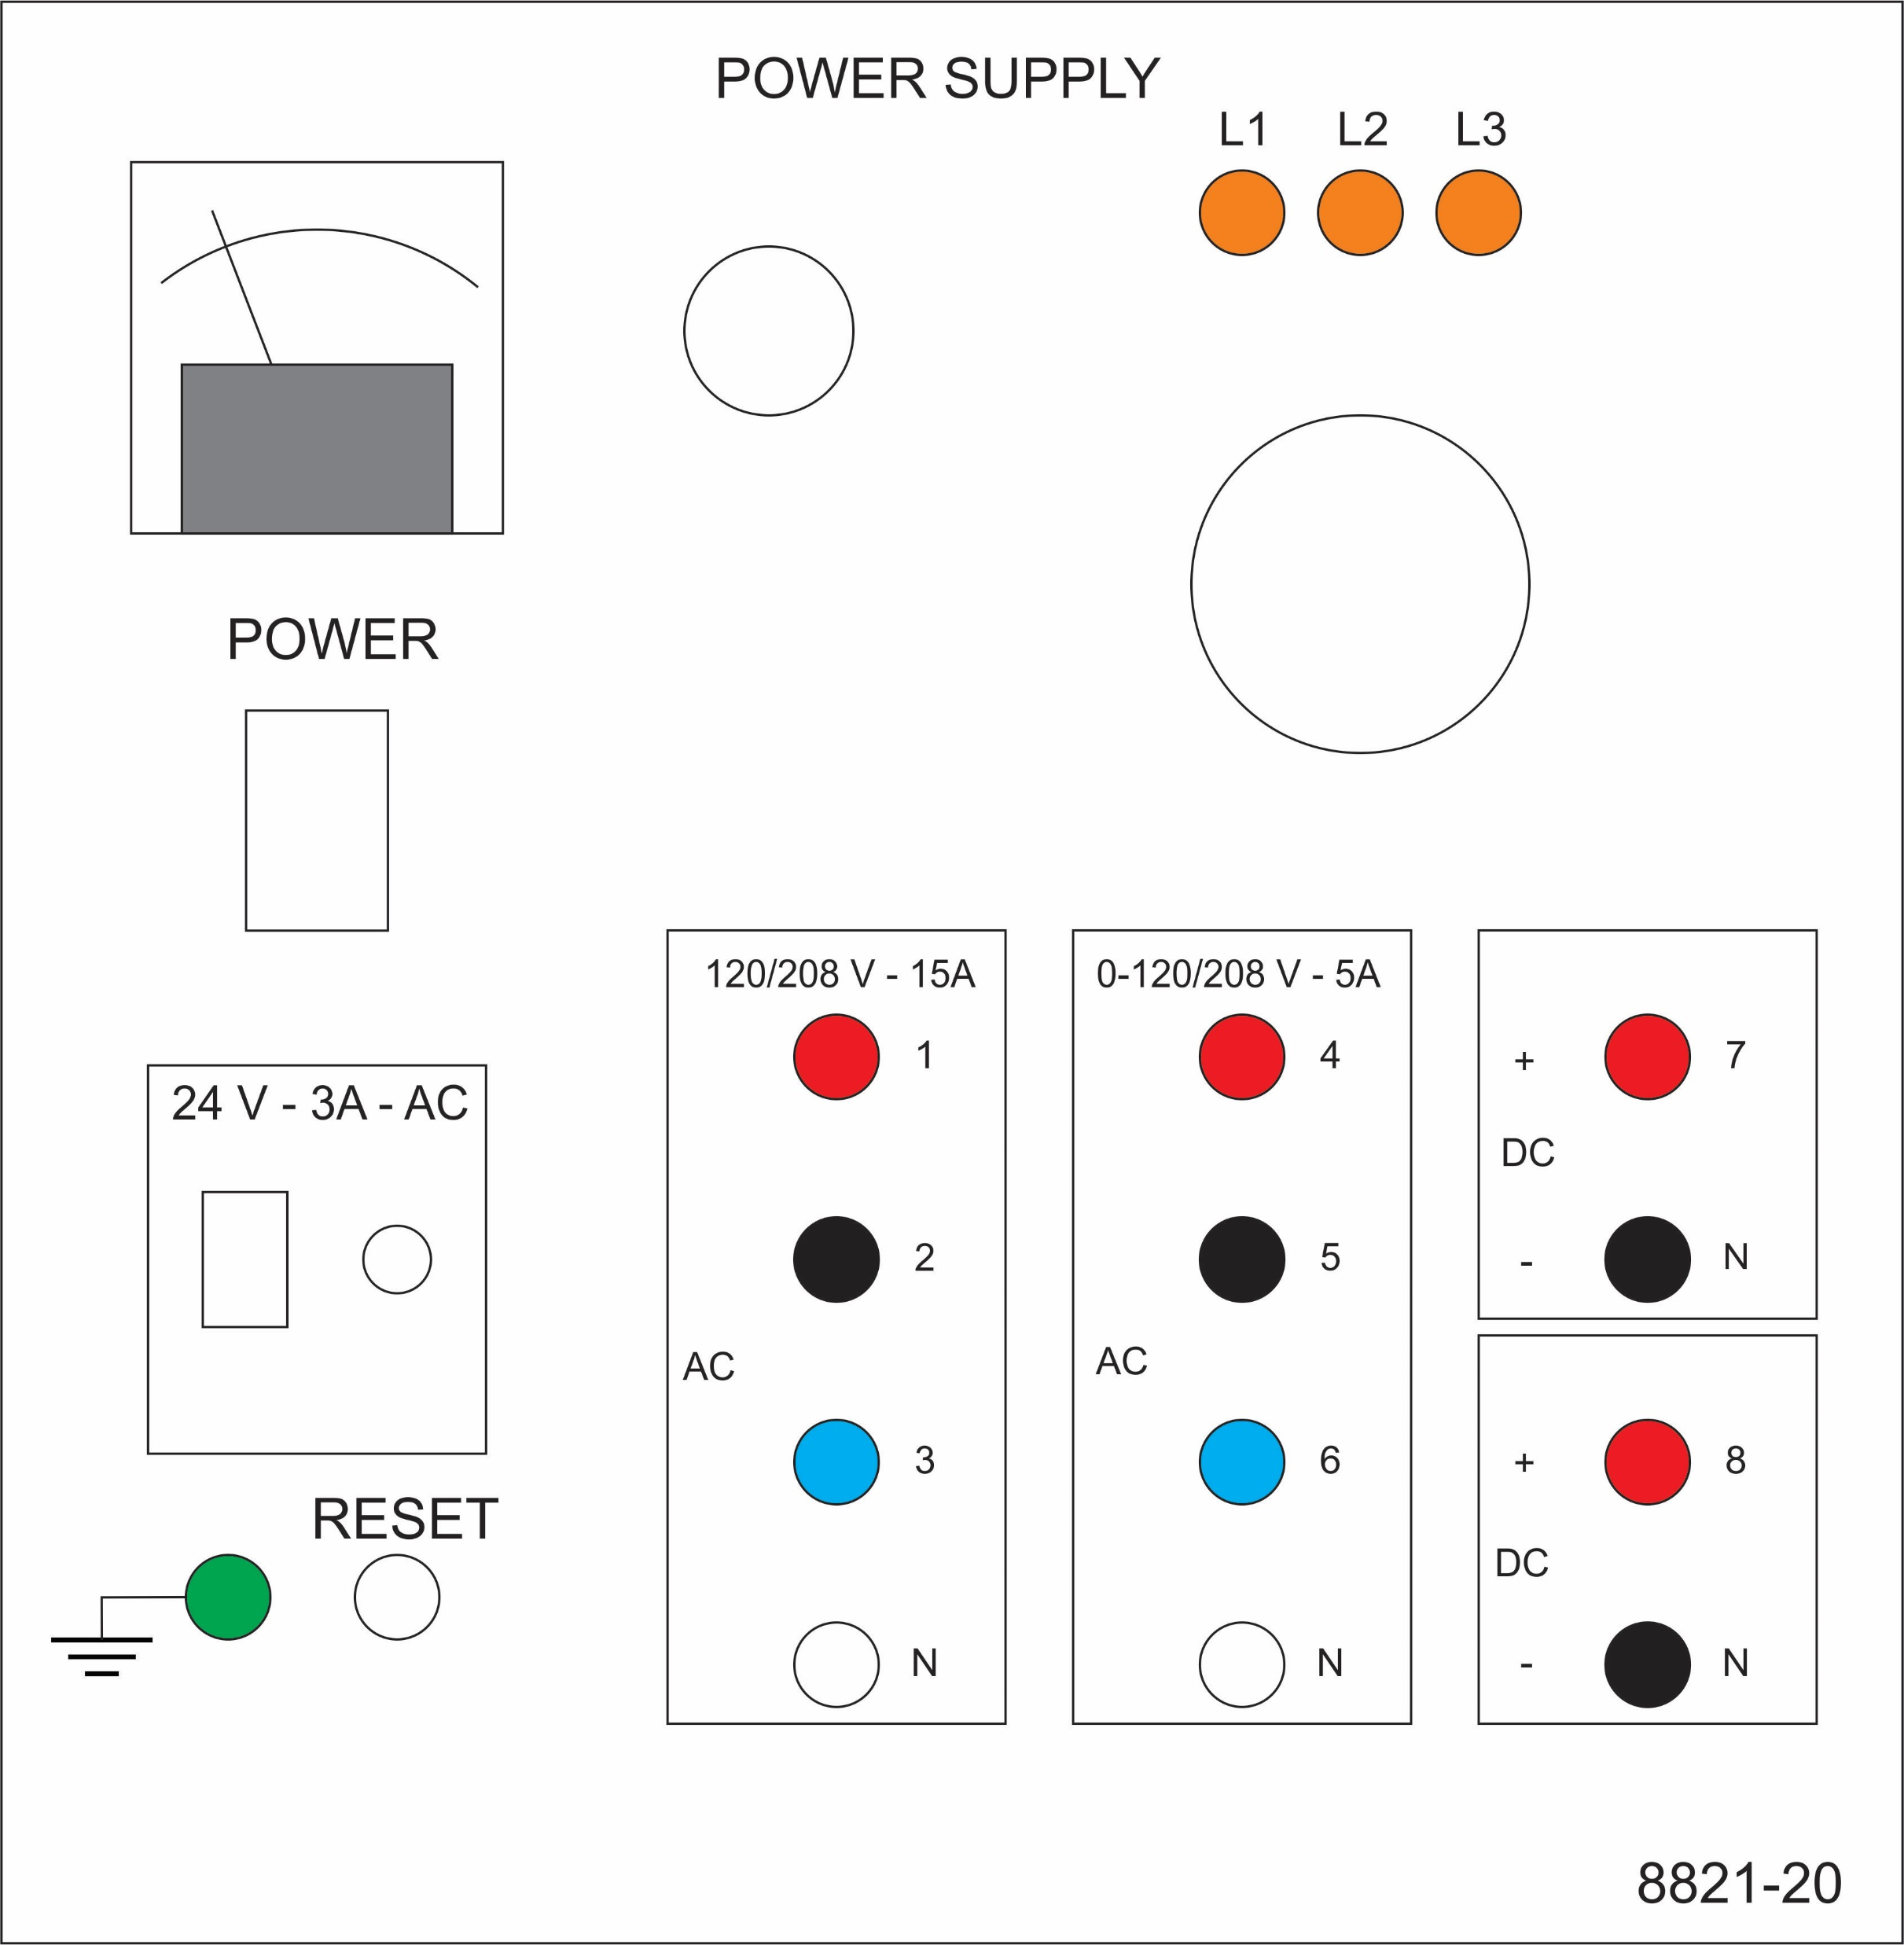
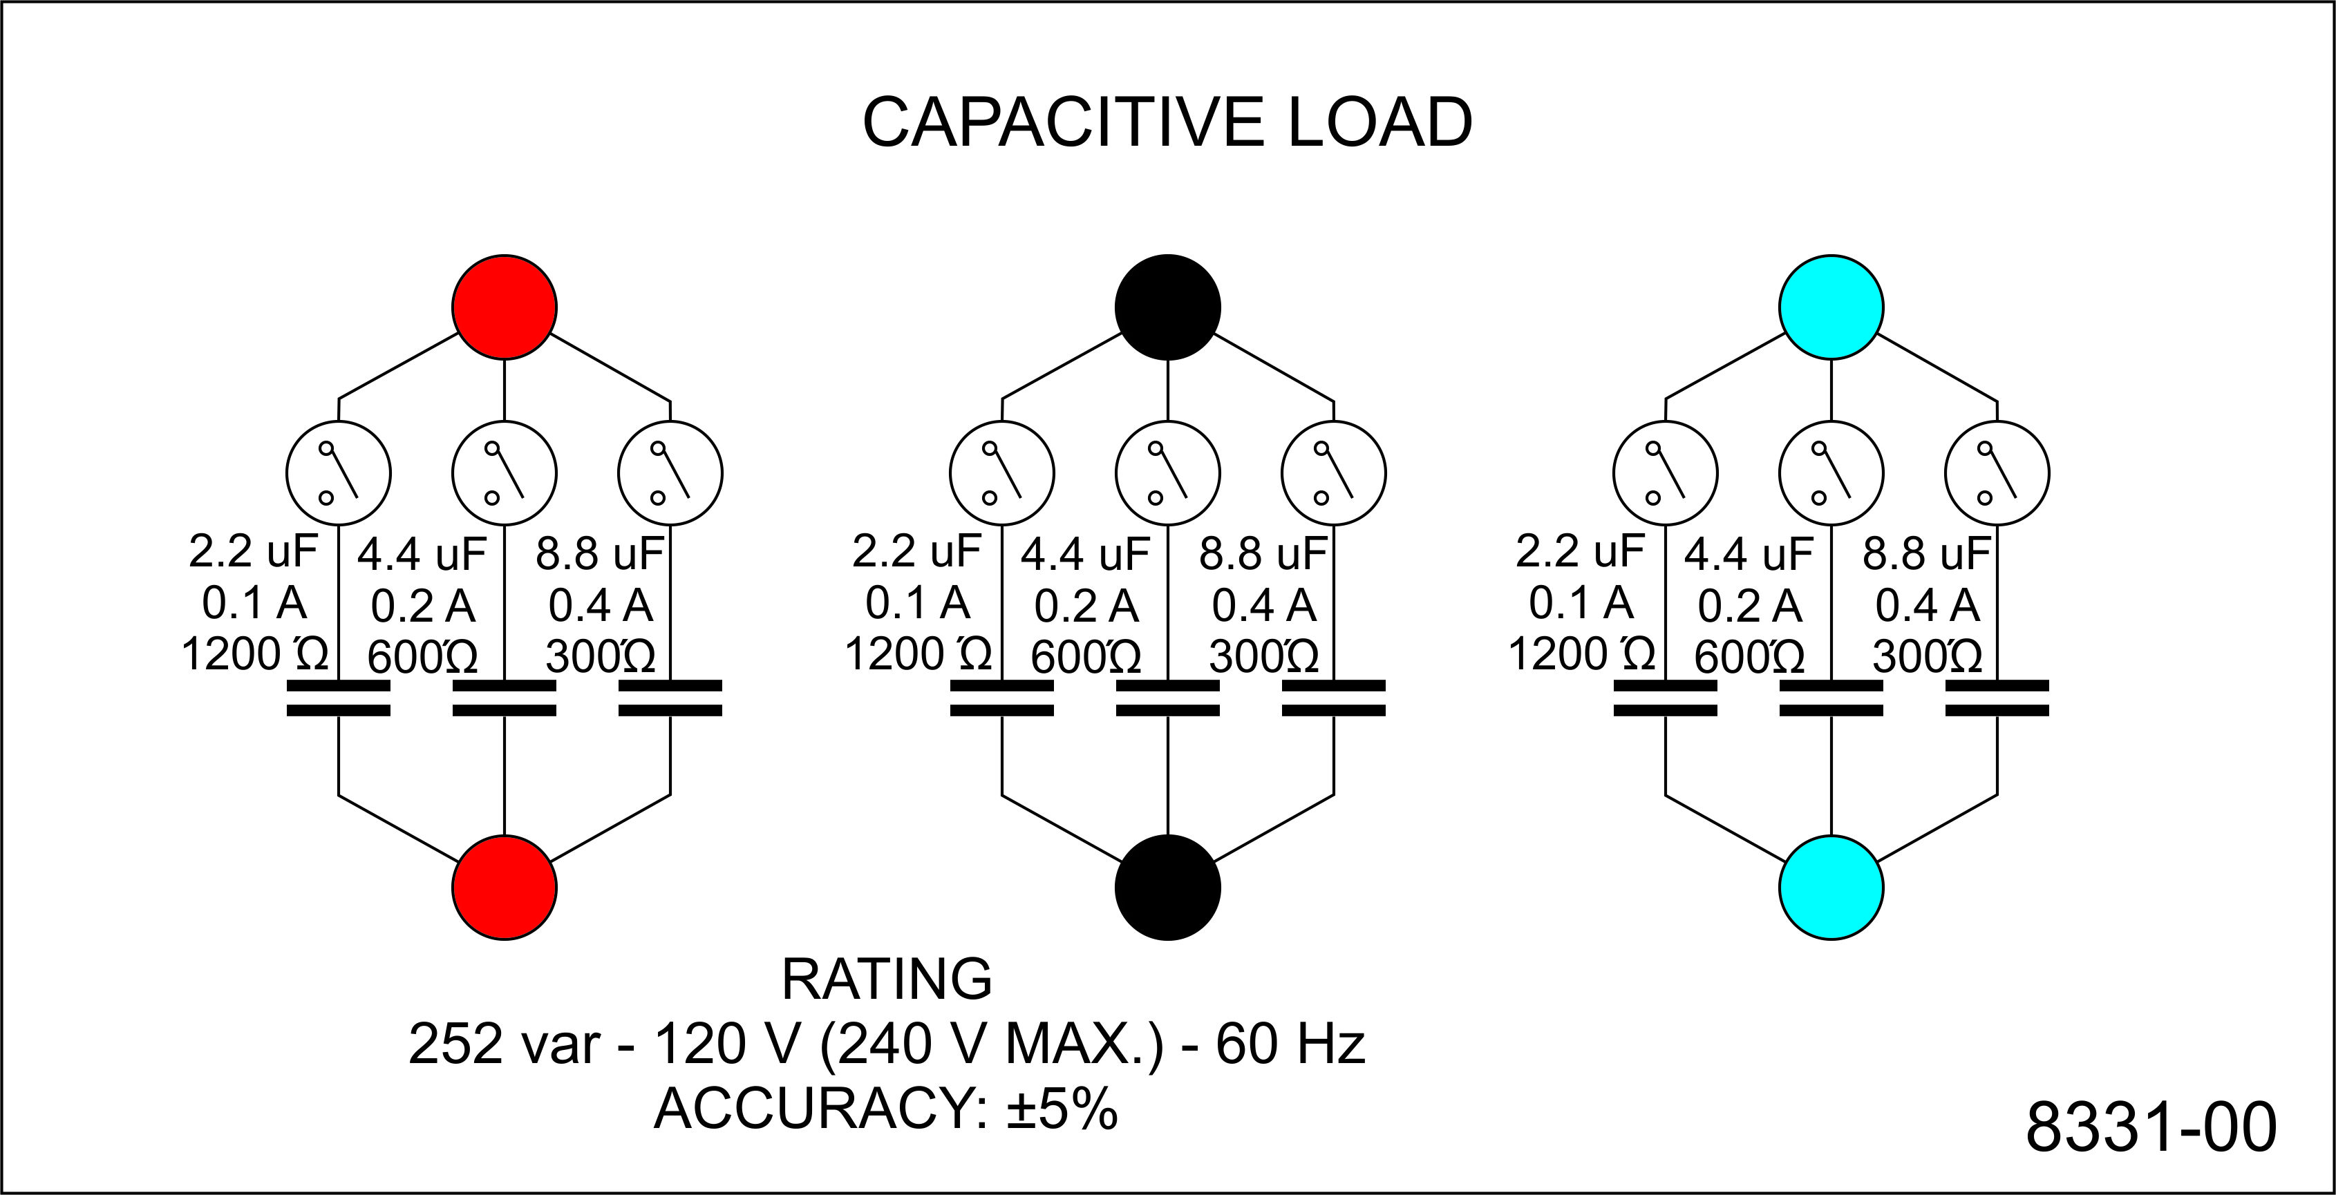
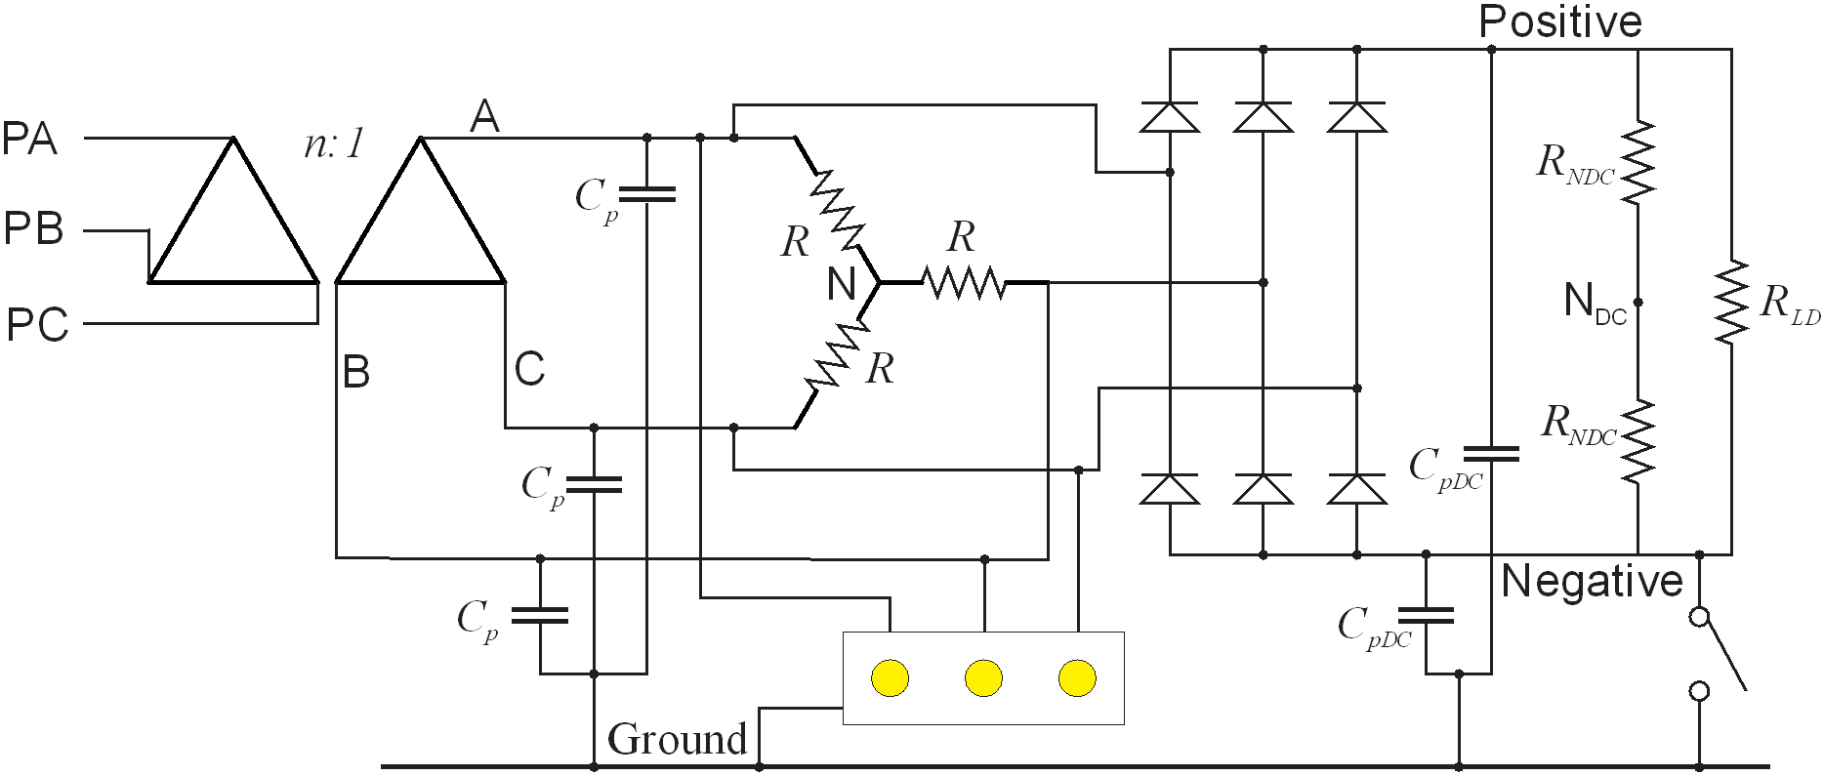
Experiment 11
Secondary - LG
Secondary line
Wye
DC Parasitic
Parasitic
DC neutral and -Load

Slide 4
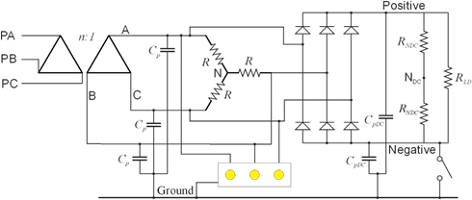
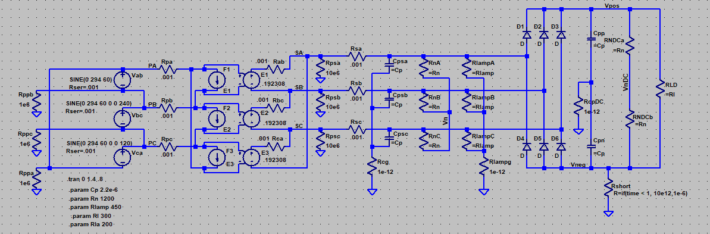
Simulation Model
LTspice
20241027 experiment 11.asc

Slide 5
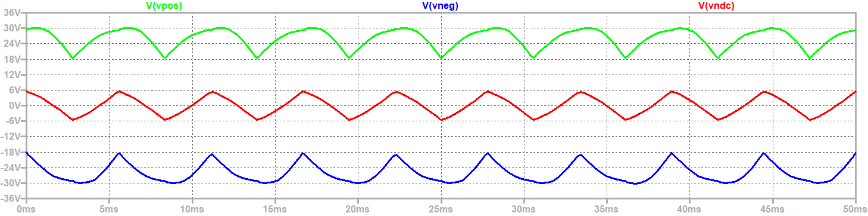
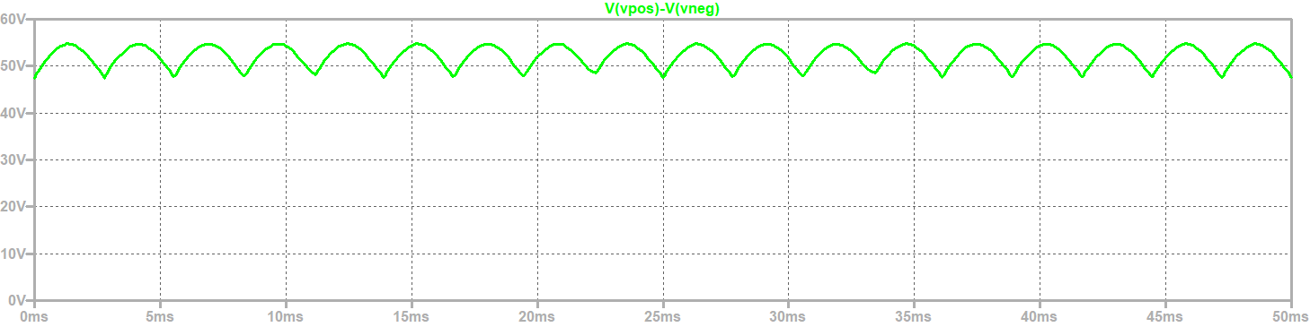
Steady State Voltages (DC side)
DC line-to-ground voltage
Common
Mode
Voltage
(ref Ground)
DC line-to-line voltage
Six Pulse

Slide 6
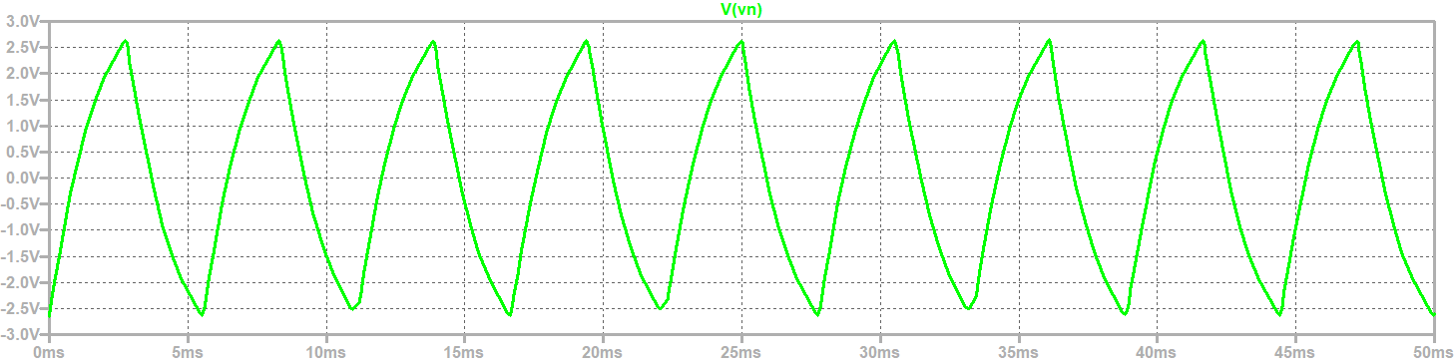
Neutral to ground voltage (AC Side)

Slide 7
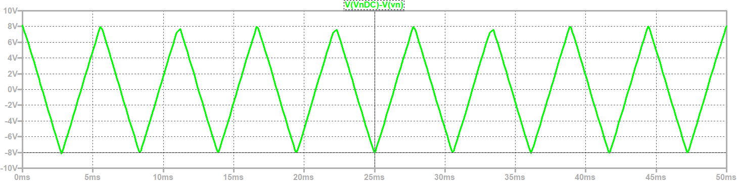
Common mode voltage
(DC neutral ref AC Neutral)

Slide 8
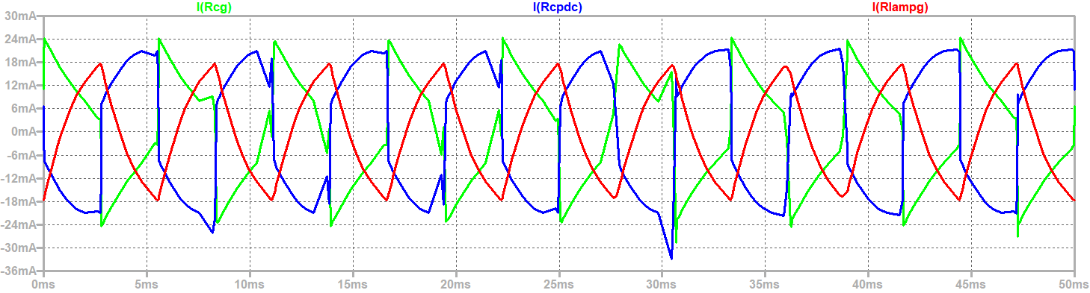
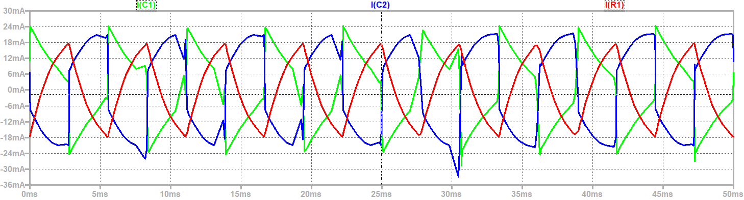
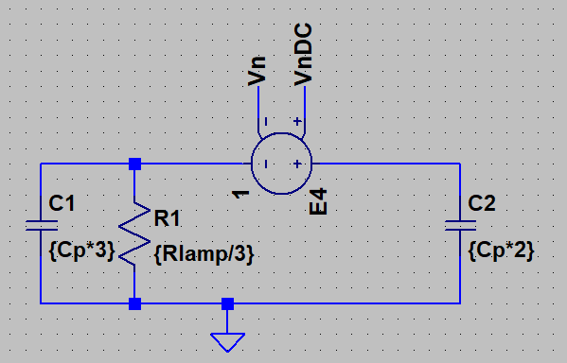
CM Current through Parasitic Capacitances and lamp resistances
Common Mode Model

Slide 9
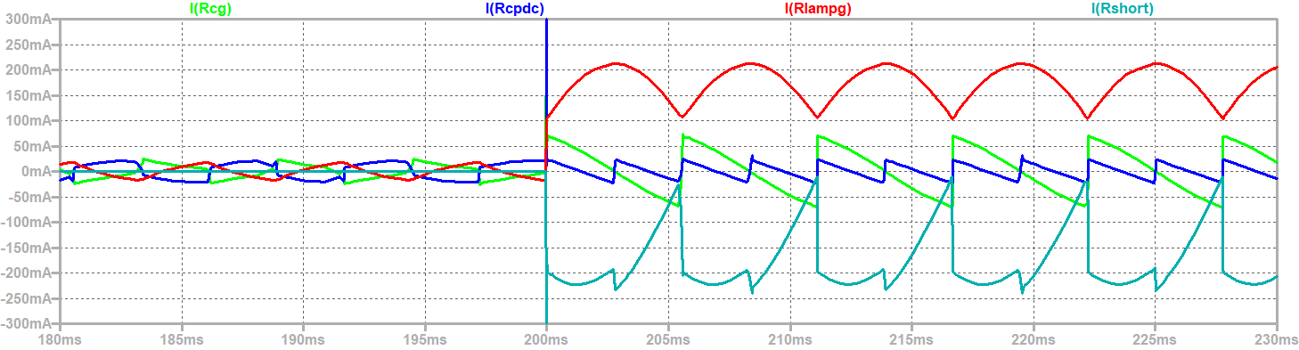
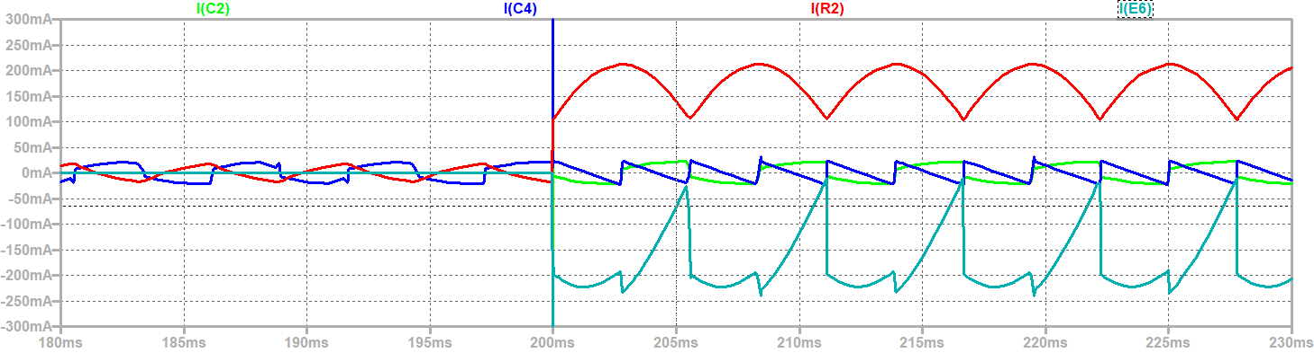
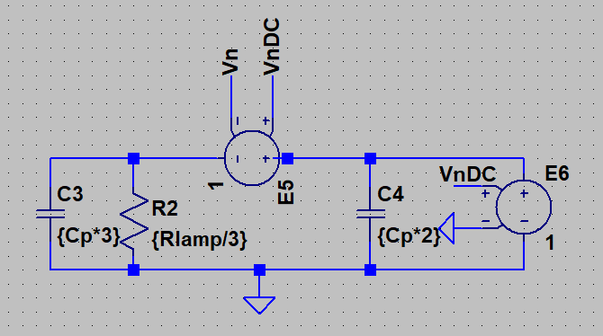
CM currents during DC ground fault
Common Mode Model

Slide 10
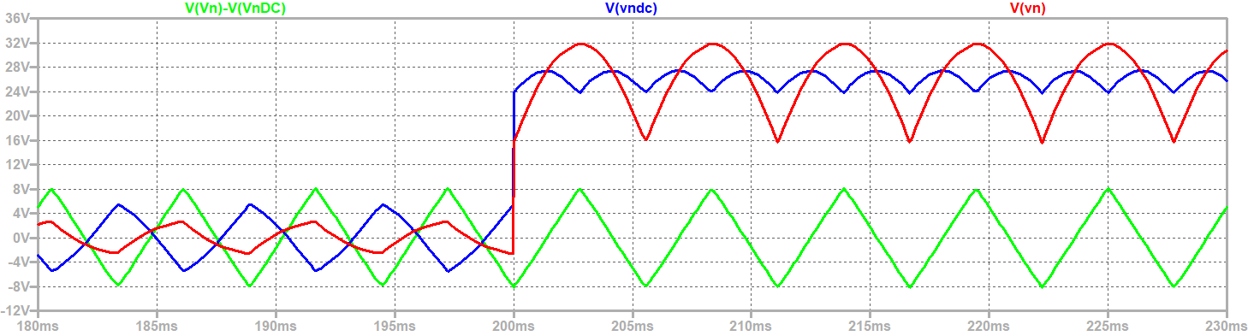
Common Mode Voltages

Slide 11
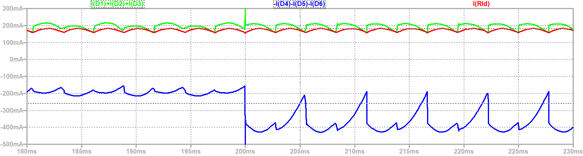
Rectifier and load currents

Slide 12
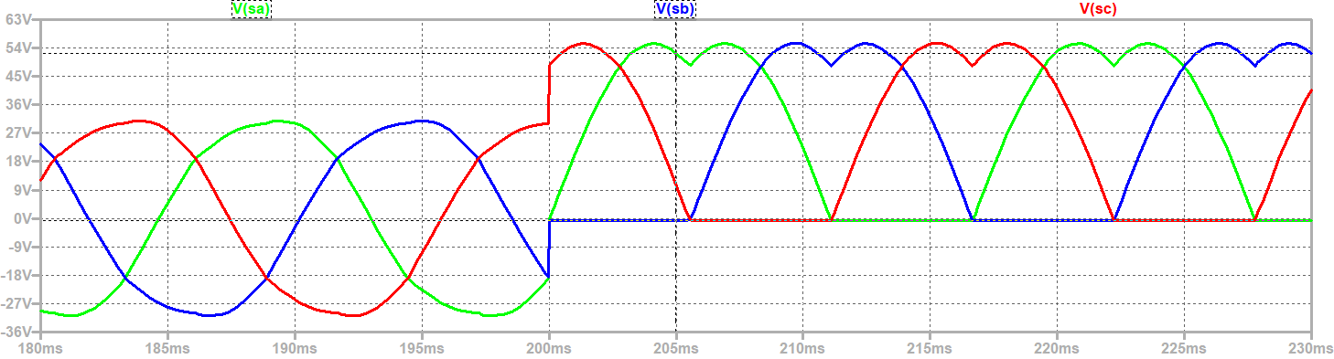
AC Line to Ground Voltages
Lamps will have equal brightness during DC ground fault

Slide 13
Wrap Up

